Slide 1


Fantastic OSINT (and where to find it)

Slide 2
BLUF
For those who don’t want to stick around..
https://blindseeker.com/ccc

Slide 3



Whoami
Tony Robinson/da_667
Malware hunter
Intel analyst
NSM enthusiast
Killer of ayys
Just zis guy. You know?

Slide 4


Greatest Accomplishments:
Spoke at numerous conferences.
Was once classified as a social media threat by ESET
I’ve been told I tell good stories.
Recently had a massive research paper on ransomware published.
blog.talosintel.com/2016/04/ransomware.html

Slide 5
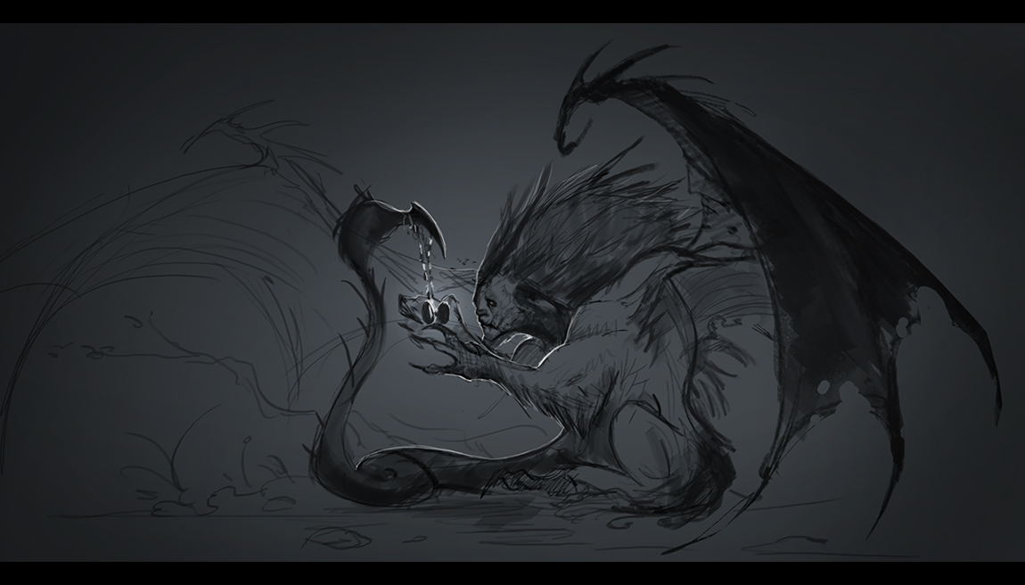

What is OSINT?
Open-source Intelligence
In a nutshell – Information gathered from public data sources
No spies required!

Slide 6
What does OSINT have to do with information security?
Infosec likes to “borrow” military terminology.
OSINT Tied to the rise of “threat intelligence”
What does it look like?
Indicators of Compromise (IOCs)
File Hashes
IP addresses
Domains
Host-Based Artifacts
Network-Based Artifacts

Slide 7

Examples of OSINT in action
Most threat intel/hunting/SOC roles make use of OSINT.
github.com/da667
I may have wrote some things.

Slide 8
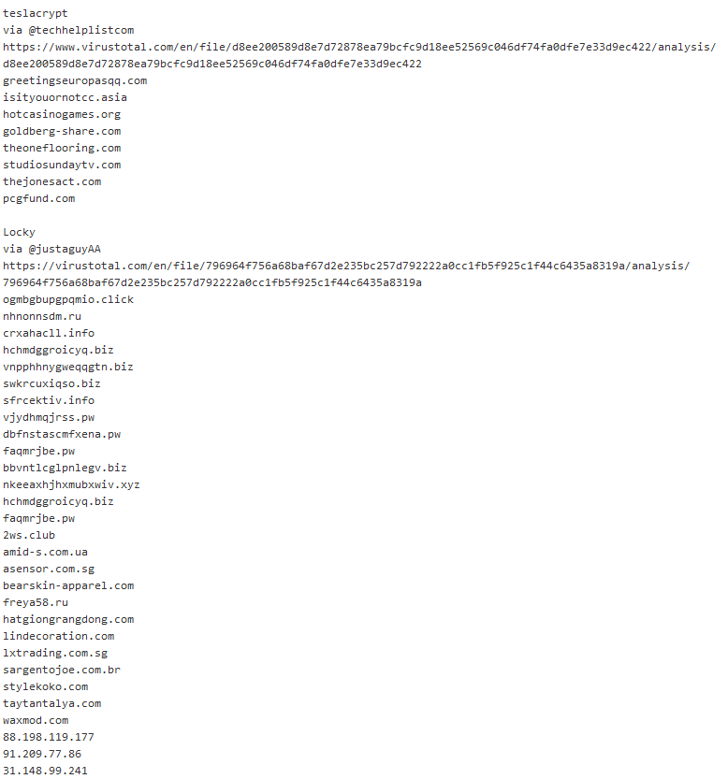

Slide 9

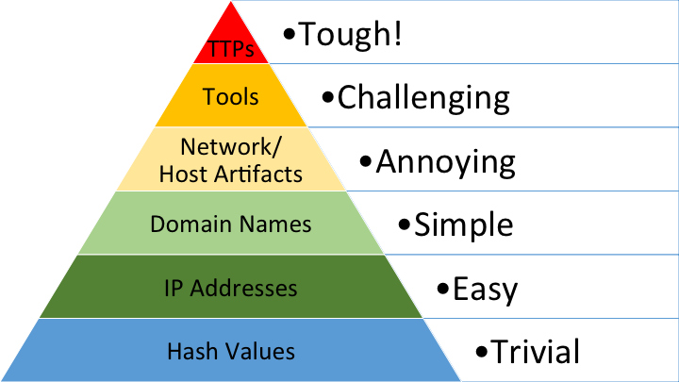
The “Pyramid of Pain”

Slide 10
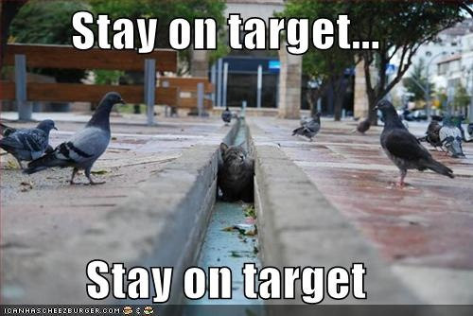
Pyramid of Pain and OSINT
Easy to obtain != Worthless
Prerequisite, usually
APT focused
Don’t lose perspective

Slide 11
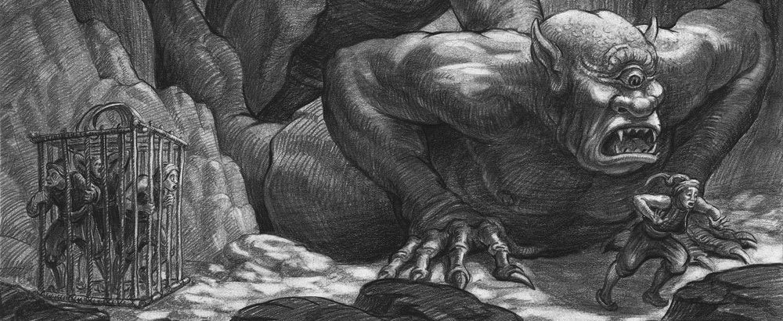
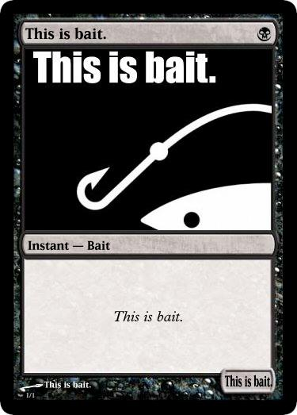
Where do I look for data?
Social Media
Twitter, mainly.
Various websites
IOC Sharing sites
Malware/threat trackers
Malware Analysis sites/suites

Slide 12
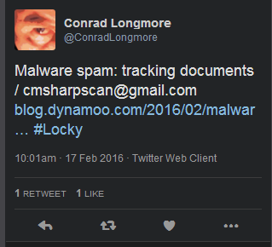
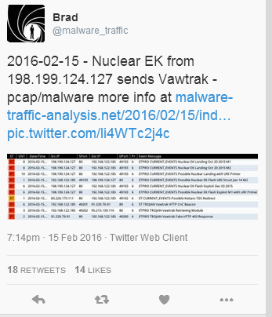
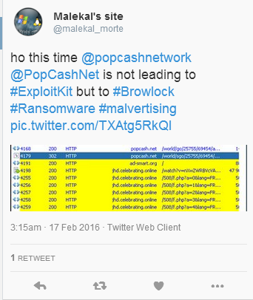
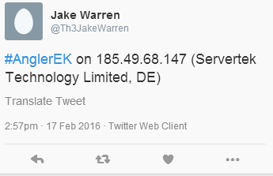
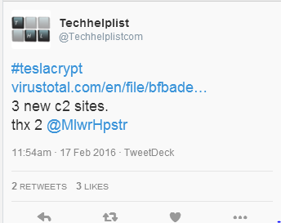
Social Media

Slide 13
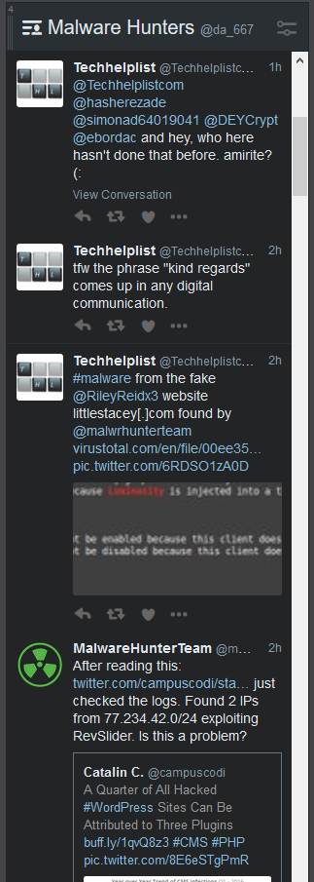
Social Media
Twitter
Use tweetdeck, set a column, and you’re done.
twitter.com/da_667/lists/malware-hunters

Slide 14
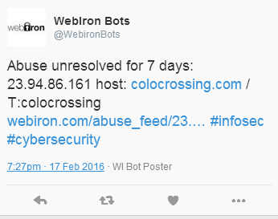
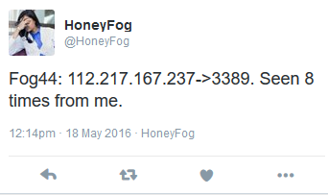
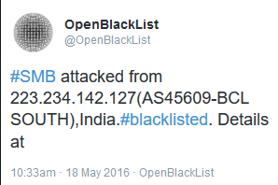
Bonus Round: Honeybots
Twitter bots attached to honeypots
Can be used to make blacklists
twitter.com/da_667/lists/threat-tracking
Based on @foospidy’s list

Slide 15


Websites
IOC Sharing portals
Threat/Malware trackers

Slide 16
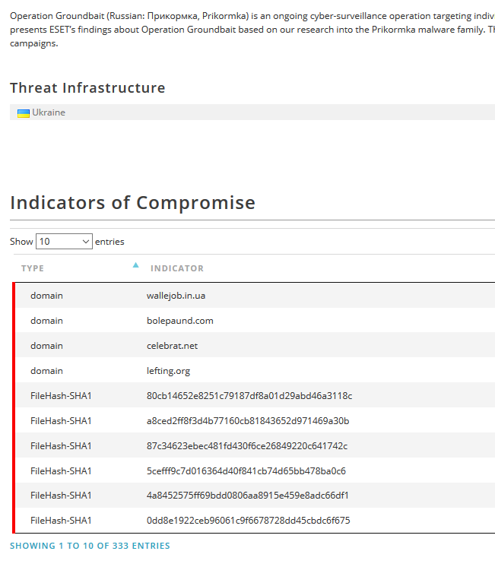
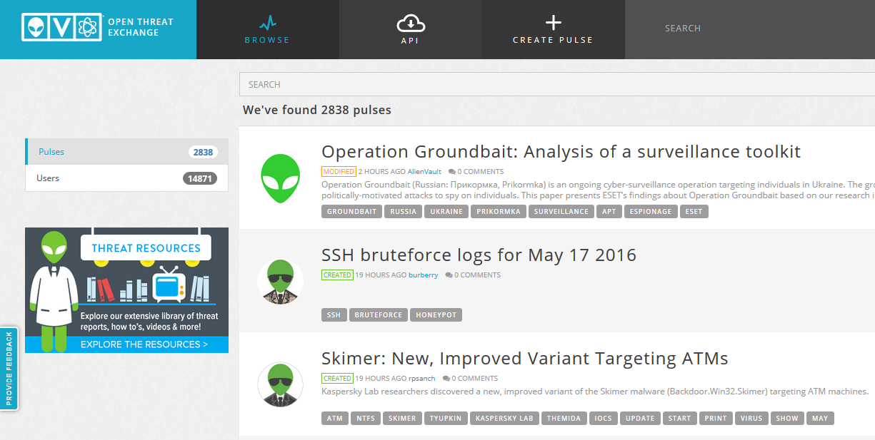
Favorite sites for data gathering:
Alienvault OTX
otx.alienvault.com
Free for anyone to browse
Create account to export IOCs

Slide 17
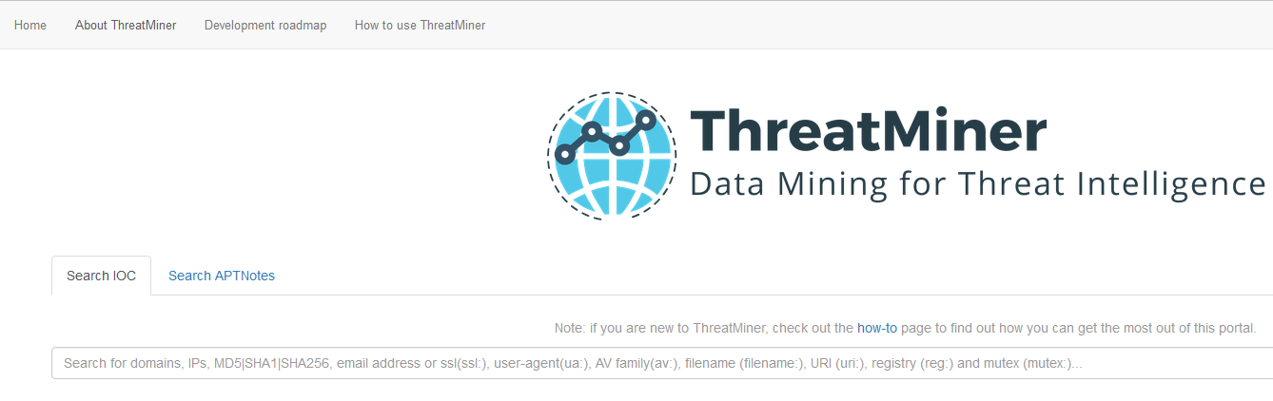
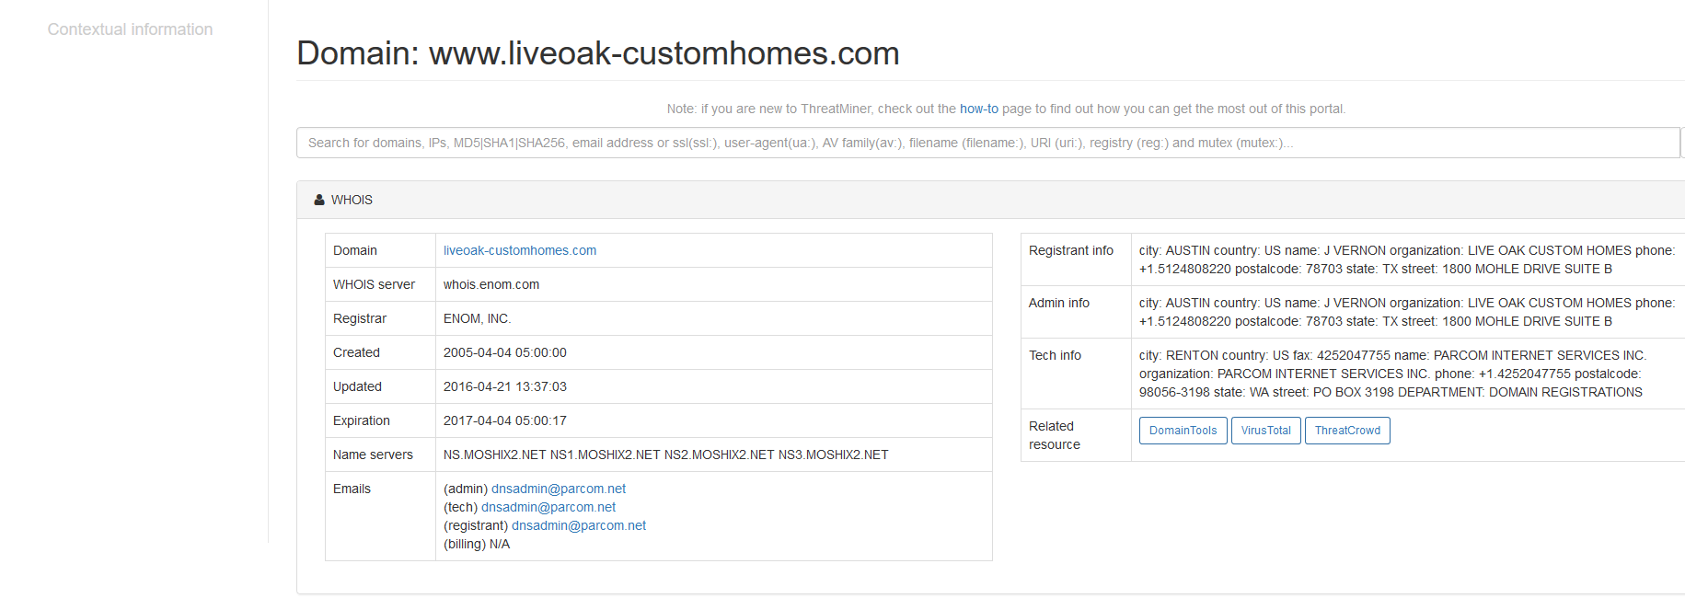
Favorite sites for data gathering (Cont’d):
Threatminer

Slide 18
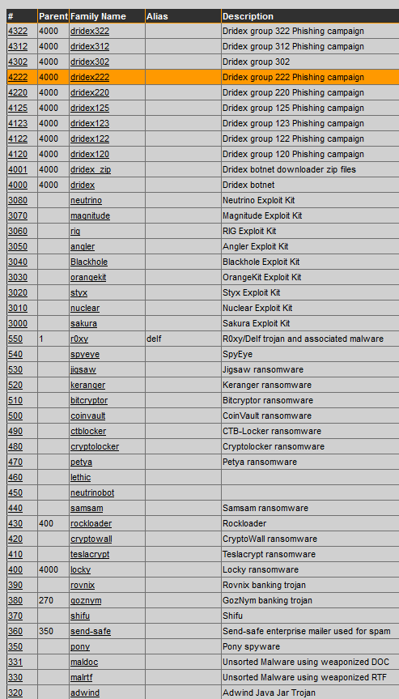
༼つ◕_◕༽つ:
Malware Corpus Tracker
tracker.h3x.eu

Slide 19
Other great datamines:
www.webiron.com/abuse_feed
www.blueliv.com
cybertracker.malwarehunterteam.com
malwaredb.malekal.com
vxvault.net/ViriList.php
www.iocbucket.com
virusshare.com
Note: Requires invitation. Not hard to get ☺
contagiodump.blogspot.com
postmodernsecurity.com/2015/09/11/malware-analysis-and-incident-response-tools-for-the-frugal-and-lazy/

Slide 20
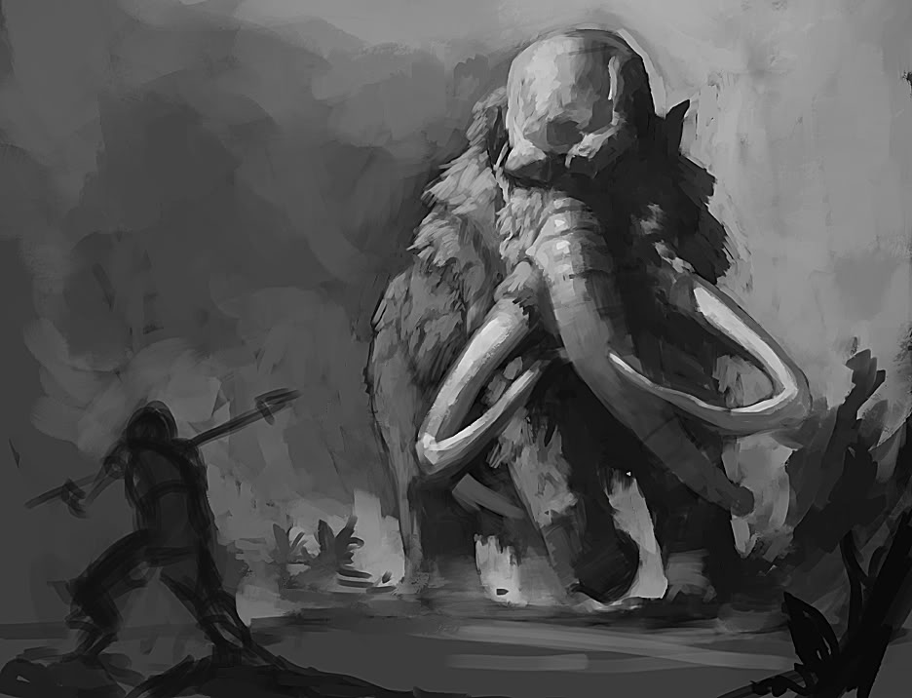
Now that I have this data…
What can you do to improve it?
Data pivoting/refining
In most cases, one data point can lead to more.
The more data you have, the more complete the picture becomes.

Slide 21
Data Refineries
Overlap with data mining sites
Not mutually exclusive…
Categories:
Free
Freemium
Commercial

Slide 22

DNS/IP Address pivoting
OpenDNS Investigate
Commercial OpenDNS offering
“Show me other IP addresses associated to this domain”
“Show me other domains on a given IP address”
“Show me where this e-mail address was used to register other domains”
“Show me a reputation score for this domain”
“Are there malicious samples associated to this IP/Domain?”

Slide 23
Example:
malware-traffic-analysis.net/2016/05/18/index.html
IOCs:
188.138.70.181
(plotow-familycontract.unishadeverticalsystem.co.uk)
144.76.82.19 (post-infection callback)
What else is hosted at 188.138.70.181?
Are there domains associated with 144.76.82.19?

Slide 24
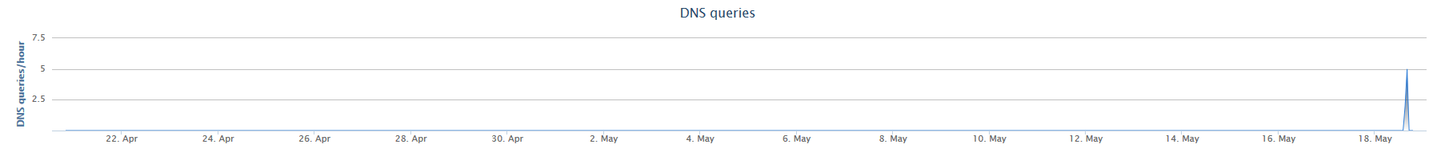
Example (cont’d)
Some other domains at the 188 address
All domains have a low number of dns queries per hour with no activity (until very recently)
Possible sign of maliciousness, DGA, new C2, etc.
Domains “look like” DGA
Gibberish combined with dictionary words, etc.

Slide 25
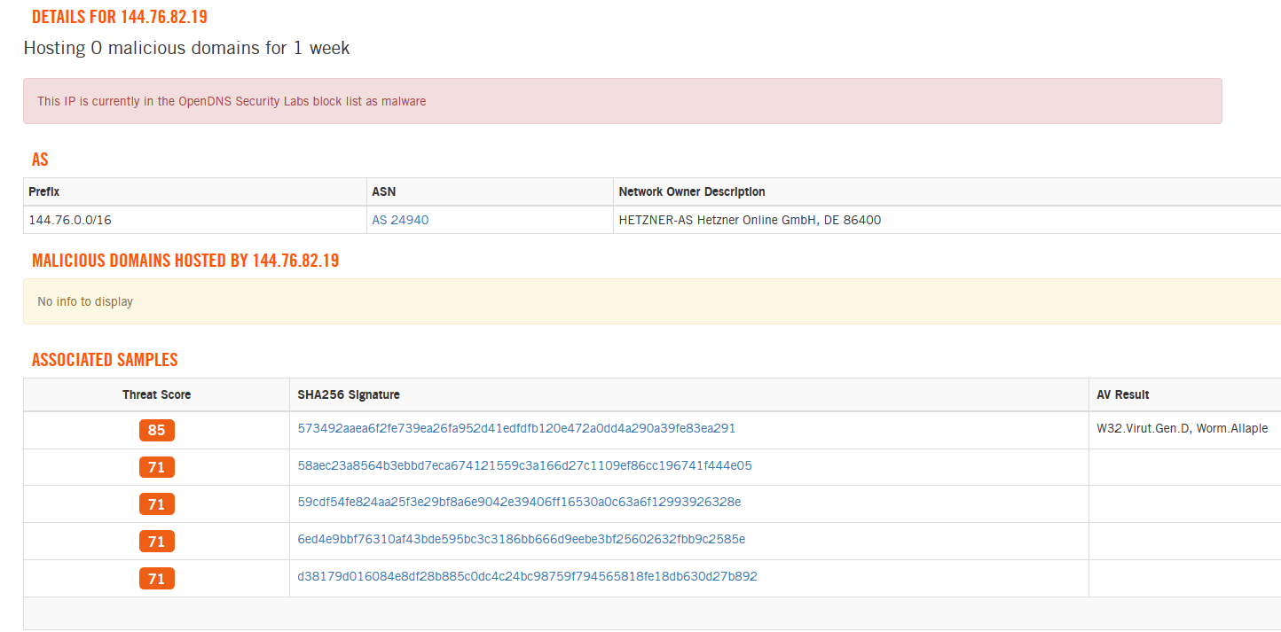
Example (cont’d)
144.x?
No known domains but…

Slide 26
Example: (Conclusion)
188.138.70.181
Known bad Domain:
plotow-familycontract.unishadeverticalsystem.co.uk
Other domains – Guilty By Association (GBA):
amackerndringerne.unishadeverticalsystem.co.uk
finalowejraskaudet.unishade.co.uk
hongersn.unilux-fabric.co.uk
insolventieafronselt.unishadeverticalsystem.co.uk
instrumenat1.unishade.co.uk
kehitetty.unishade.co.uk
nzbturcomana.unishade.co.uk
rintenyo.unishade.co.uk
similicuir-unelastische.unilview-fabric.co.uk
valtakulttuuriksi.unishadeverticalsystem.co.uk
verlakdiscessuque.unishadeverticalsystem.co.uk
144.76.82.19
No new domains, but we know it’s bad now

Slide 27
DNS/IP Address - Alternatives
passivedns.mnemonic.no
www.bfk.de/bfk_dnslogger.html (no API/bulk requests)
PassiveTotal
VirusTotal
Farsight (Free for academic research, otherwise Commercial)
DomainTools (Commercial)
Circl.lu (subject to approval)

Slide 28

File Hashes/File Analysis, etc.
VirusTotal Intelligence
If you have VT Intel, USE IT.
Real-time and retroactive search for samples via yara
VT Intel + yara rules for RATs + BAMFDetect (github.com/bwall/bamfdetect) = fun
VT does pcaps pretty well..
“Similar-to” is amazing.

Slide 29
File Hashes/File Analysis, etc.
VirusTotal (free)
What if you don’t have VT Intel access?
Standard VT gives important details:
Has the file been seen before?
Who detects it as what?
Was it submitted/related to other files?
If there are any comments, for the sample, be sure to check them.
Standard disclaimer: Any files you submit become /their/ files..
Anyone with private API or VT Intel can download the stuff you uploaded.
Google is watching you.. (Geolocation, IP address, possible detection of TOR submissions, FYSA..)

Slide 30
Example Hash/File Hunting
virustotal.com/en/file/356b71c378f779f9a5e4cd9990dbef17d7c989b2d024328e9fabe96a3e94d884/analysis/
We know that this is the stage 2 (The actual ransomware EXE)
Questions to ask:
Where did this file come from?
Where does it call back to?
Are there other, similar files out there?

Slide 31
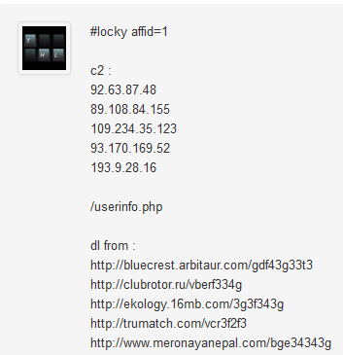
Check the comments!
Download locations:
bluecrest.arbitaur.com/gdf43g33t3
clubrotor.ru/vberf334g
ekology.16mb.com/3g3f343g
trumatch.com/vcr3f2f3
www.meronayanepal.com/bge34343g
C2:
92.63.87.48
89.108.84.155
109.234.35.123
93.170.169.52
193.9.28.16

Slide 32
End Result:
We recovered Stage 2 sites
We recovered C2 information
Both of the above can be fed into our DNS tools for even more data mining/refinery
Not much activity on related files, but that’s okay.

Slide 33
File Hash/File Analysis - Alternatives
Alternatives to Virustotal:
www.hybrid-analysis.com
malwr.com
camas.comodo.com
Roll your own
digitalizedwarfare.com/2016/03/24/sandbox-stories-flight-of-the-great-cuckoo-bird
zeltser.com/automated-malware-analysis
Based Lenny Zeltser, malware analysis god.

Slide 34


Passive Information Gathering
Traditionally used for offensive engagements
Why should red team have all the fun?
What other peers are out there?
What other services are hosted?
Where are they located?
Vulnerabilities discovered?

Slide 35
Passive Information Gathering
shodan.io
Really needs no introduction
Pros: Tons of data and services indexed
Cons: Very limited, unless you are still in school or have an enterprise account
Uses: you found a malicious IP address. Enter the IP address block
What other IP addresses have been indexed?
What services are they hosting?
Anything suspicious/possibly vulnerable/compromised?

Slide 36
Passive Information Gathering – Alternatives/Additional Data
ipintel.io
www.netcraft.com
he.net
www.team-cymru.org/IP-ASN-mapping.html
www.shadowserver.org/wiki/pmwiki.php/Services/IP-BGP
www.punkspider.org
Censys.io

Slide 37

Questions?
AYY

